Slide 1
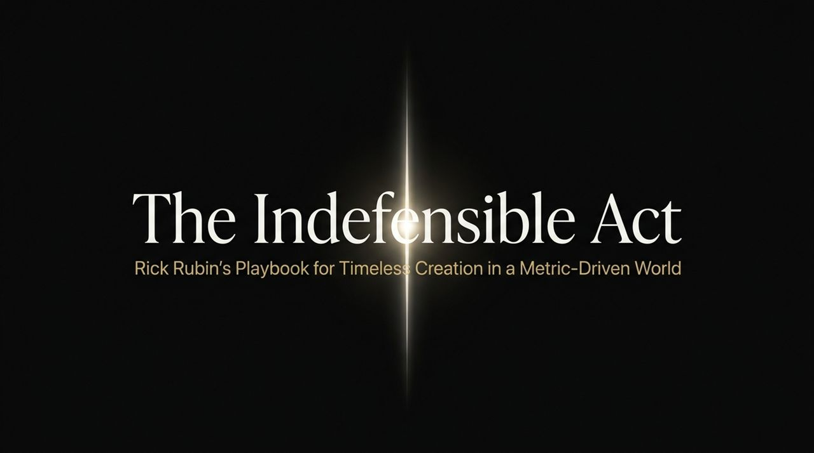
Notes:
Welcome, everyone. Today, we’re looking at what it takes to produce truly timeless creative work in a world obsessed with short-term metrics. We’re drawing from Rick Rubin's playbook—a producer who has guided icons from Jay-Z and Kanye West to Johnny Cash and System of a Down over a 40-year career.
To understand Rick’s mindset, we must first distinguish between two fundamentally different games: The Commerce Game and The Art Game.
In the Commerce Game, the driving forces are near-term incentives, data, and algorithms. You start with the customer, work backward from their demands, and design your process to minimize risk and hit quarterly deliverables. It’s a game of incremental, predictable gains.
In contrast, the Art Game operates on internal resonance. The target audience isn't a demographic or focus group—it’s yourself. Your primary goal is to please your own internal taste and treat the work as a diary entry. Instead of avoiding risk, you embrace extreme, 'indefensible' risk. The timeline isn't quarterly; it's eternal.
As Rick Rubin points out: 'The more numbers game is a shorter-term game. I've been making things for 40 years. I have never done it the way you're suggesting.' When you design purely for metrics, you trade cultural impact for short-term safety.
Rick Rubin: The Only Skill That Matters Now Is The One Thing AI Can Never Steal!
https://www.youtube.com/watch?v=a_GiFiHXJ6g

Slide 2
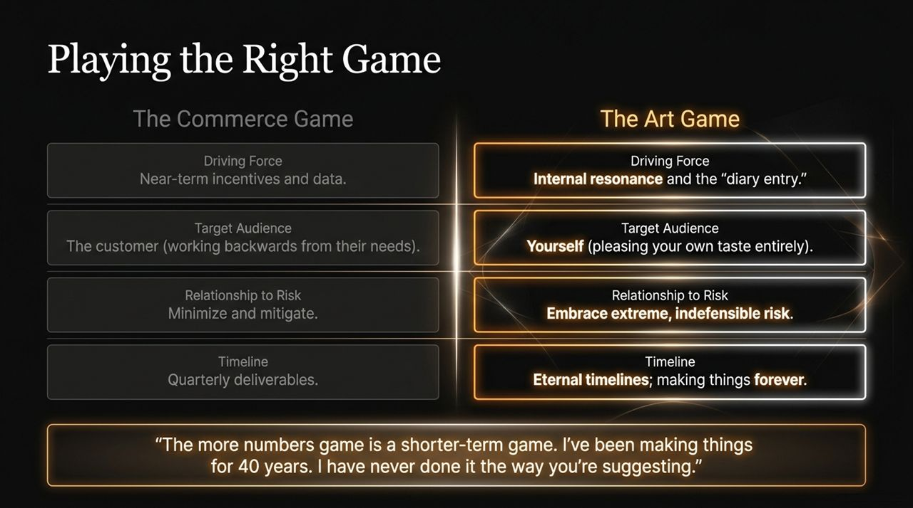
Notes:
One of the greatest dangers to long-term creativity is what Rick calls the Identity Trap. Early in life or career, we adopt labels—'Lawyer,' 'Producer,' 'Executive,' or 'Father'.
The trap is that we trade fundamental creative freedom for titles that look impressive at cocktail parties or on LinkedIn. But any label you accept narrows your perspective and makes your creative world smaller.
Escaping this trap requires hitting the 'Reset Button'. It means allowing a career path, lifestyle, or static relationship to end or evolve. When you drop a label, you create a vacuum. While a vacuum feels terrifying, it is the only space where new, unexpected opportunities can enter.
Look at Jay-Z. When the makers of Cristal champagne made derogatory comments toward the hip-hop community, Jay-Z didn't analyze the financial loss of cutting ties. He acted purely on principle and cut them off completely.
That action created a massive vacuum in hip-hop luxury culture. The universe filled that gap with Ace of Spades (Armand de Brignac)—a brand Jay-Z built up and eventually sold a 50% stake in to LVMH at a $630M valuation. That level of breakthrough is impossible if you stay trapped inside your existing corporate label.

Slide 3
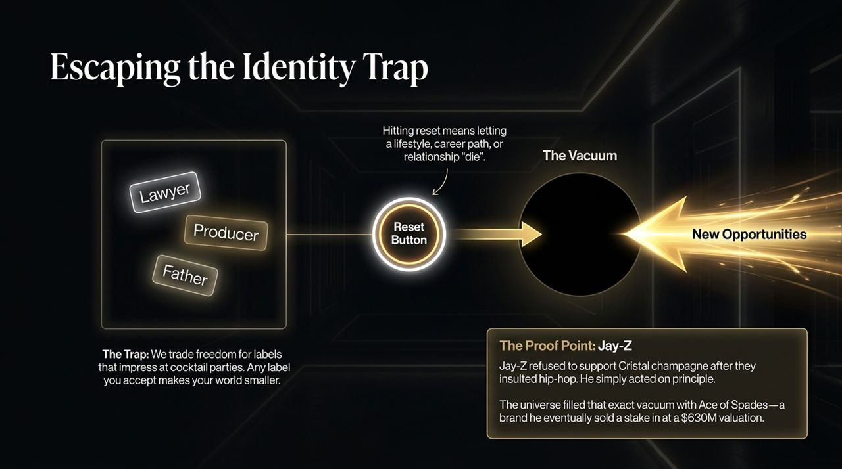
Notes:
What does it mean for a creative choice to be 'indefensible'?
If a choice is defensible, it can be justified through data, precedent, and consensus. Defensible choices lead to the Rational Path—predictable, safe, and ultimately low cultural impact.
An 'indefensible' choice exists completely beyond conventional logic. It cannot be proved on a spreadsheet before it exists. It requires tuning into universal energy or an internal calling.
The rule here is simple: Answer the invitation. When creative energy moves toward you, participate in the experiment, even if it defies your job description.
Consider Rick Rubin’s recent experience with 'vibe coding'. He began receiving hundreds of memes and references about 'vibe coding'. Rationally, an iconic 60-plus-year-old music producer should ignore a trending tech topic. But he felt energy coming from all directions.
He participated without overthinking: he posted a joke tweet that hit 1.5 million views. When that generated massive interest, he followed the next natural step: putting aside his standard professional commitments to write an entire book on a topic he initially didn't fully understand. That willingness to follow indefensible energy keeps a creative life vital.

Slide 4
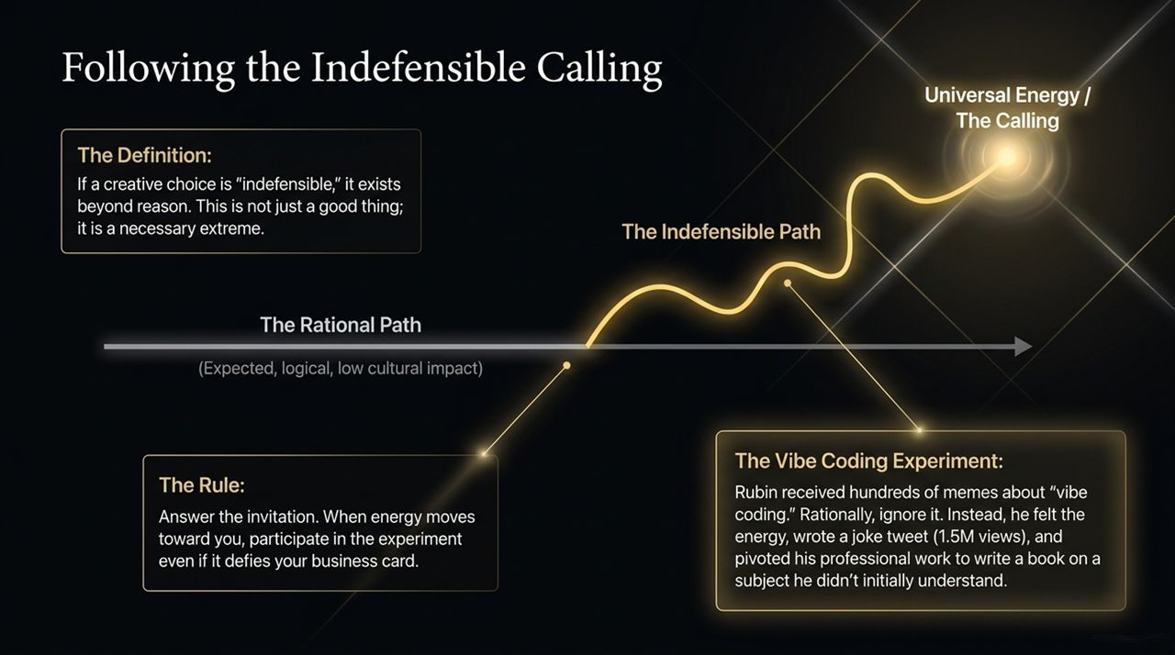
Notes:
There is a direct correlation between creative risk and cultural immortality. If everyone likes your work on the very first listen or view, it's too easy and predictable.
Let's look at three trajectories on this spectrum:
1. The Comfortable Death: Imagine a group like Linkin Park choosing to repeat their classic rap-rock sound indefinitely. You secure short-term guaranteed record sales, but over time, the genre stagnates and dies.
2. The Alienating Shift: When Radiohead released Kid A following the massive success of OK Computer, or when Kanye West dropped Yeezus, listeners were confused and alienated. Rick Rubin notes that when he first heard Kid A, he disliked it because it didn't fit his expectations. Years later, it became his favorite Radiohead album. Polarizing choices reset the cultural paradigm and build long-term value.
3. The Indefensible Breakthrough: Consider System of a Down. When Rick brought their early demo to KROQ—the premier rock station in California—the program director listened to the song 'Sugar' and said: 'Not only will we not play this record, we will never play this band on our station.' It sounded insane compared to existing radio music.
One year later, System of a Down was the #1 most requested band on that station. Decades later, they are selling out 80,000 stadium seats in Paris two nights in a row. True works arrive without preexisting context. Risk is the only path to legendary status.

Slide 5
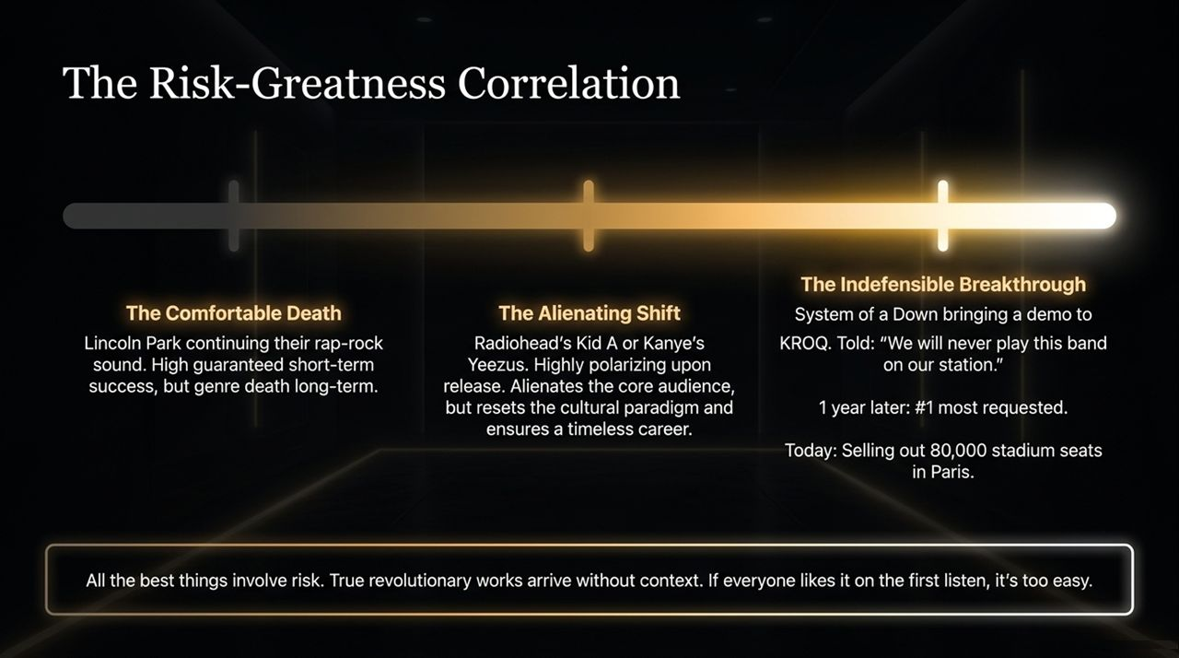
Notes:
How do we structure time for maximum artistic output? Most organizations apply deadlines at the beginning of a project. Rubin structures creation as a Timeline Funnel split into four distinct phases.
Phase 1: Seed. Pure exploration, gathering inputs, and following curiosity with zero pressure or deadlines.
Phase 2: Experimentation. Testing what the seeds want to become, following the material where it wants to go.
Phase 3: Crafting. Trimming, shaping, and editing the raw material into a coherent structure.
Notice that for Phases 1 through 3, NO TIMELINES ARE ALLOWED. If you impose a deadline during seeding or experimentation, you force standard, predictable solutions.
Phase 4: Finishing (The Final 10%). Only when the vision is crystal clear and the core problem is solved do you introduce a strict deadline. In this final stretch, deadlines serve as an essential editorial tool to bring the work into the world.

Slide 6
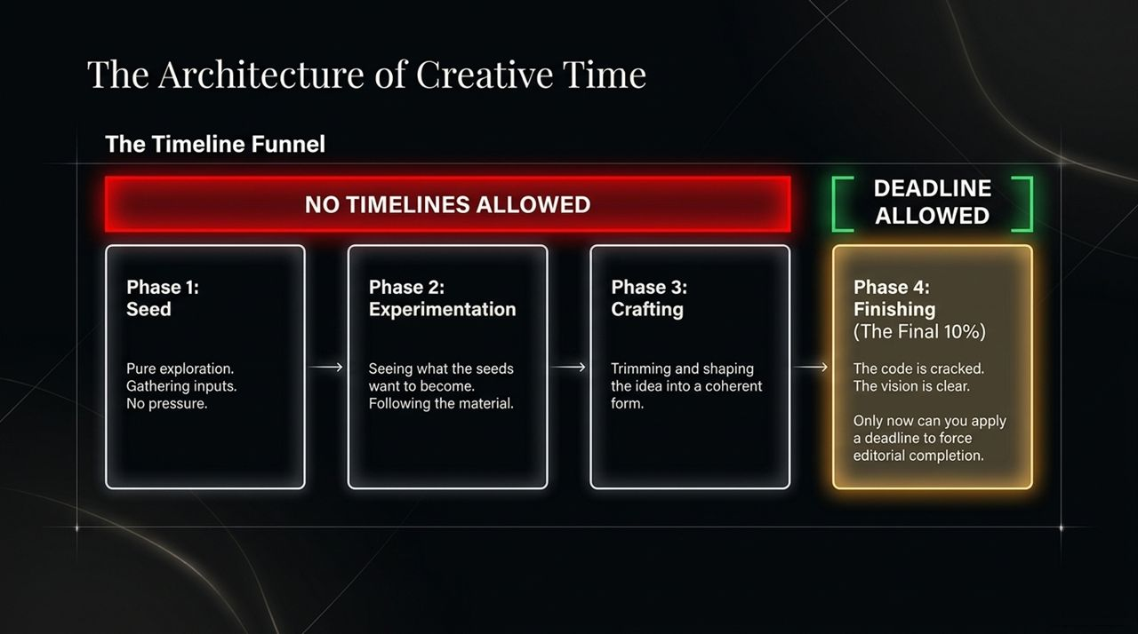
Notes:
When projects stall, leaders often label the delay as 'procrastination'. But we must accurately diagnose why a project is delayed.
The Procrastinator (Fear-Driven): The root cause is terror of public judgment. Releasing work means confronting reality and potential failure. The creator avoids finishing because holding onto an unreleased project keeps the dream safe. The longer the delay, the heavier the emotional expectation becomes.
The Perfectionist (Craft-Driven): This delay comes from an uncompromising commitment to taste. The creator isn't running away from judgment; they are showing up every single day to refine the work.
Look at Tom Petty making his masterpiece album Wildflowers. He spent 2.5 years relentlessly polishing those songs. He wasn't hiding from the public out of fear; he stayed in the studio because every vocal line, tempo, and lyric had to meet his internal standard of perfection.
As leaders and creators, know which delay you are dealing with: fear needs courage, but craft needs time.

Slide 7
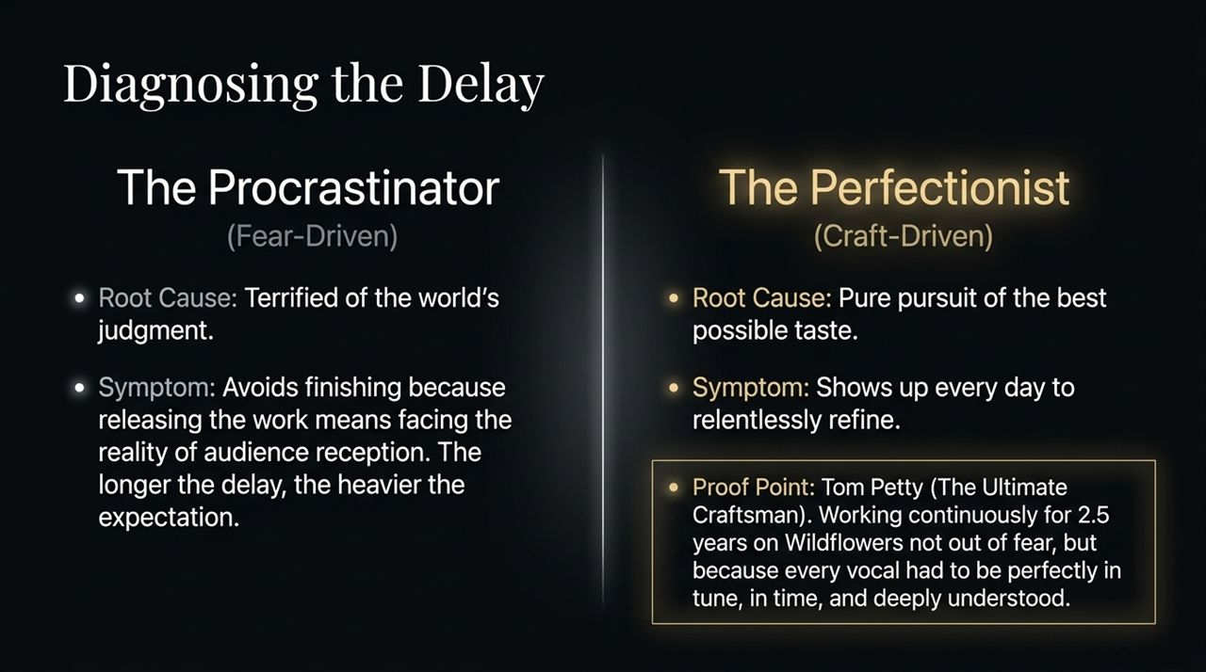
Notes:
We are all born naturally creative, but institutional systems teach us to follow rules, comply, and conform. Over time, we absorb the opinions of teachers, parents, bosses, and social media metrics until we lose trust in our internal taste.
This slide illustrates Tuning the Internal Antenna:
Module 1 (The Problem): The top layer is 'The Surface / The Noise'—constant chatter, trends, feedback loops, and fear.
Module 2 (The Catalyst): Rubin started practicing Transcendental Meditation (TM) at age 14. TM isn't just about relaxation; it's a biological and spiritual practice for building self-awareness. It quietens the surface noise so you can connect to 'The Depth / The Knowingness' below.
Module 3 (The Test): How do you evaluate your work once you've tuned your antenna? Rubin uses a simple analogy: 'Which piece of pizza tastes better to me?' You don't ask a focus group which slice of pizza you like—you eat it and know instantly. Your creative output should follow that same level of instinctive trust.

Slide 8
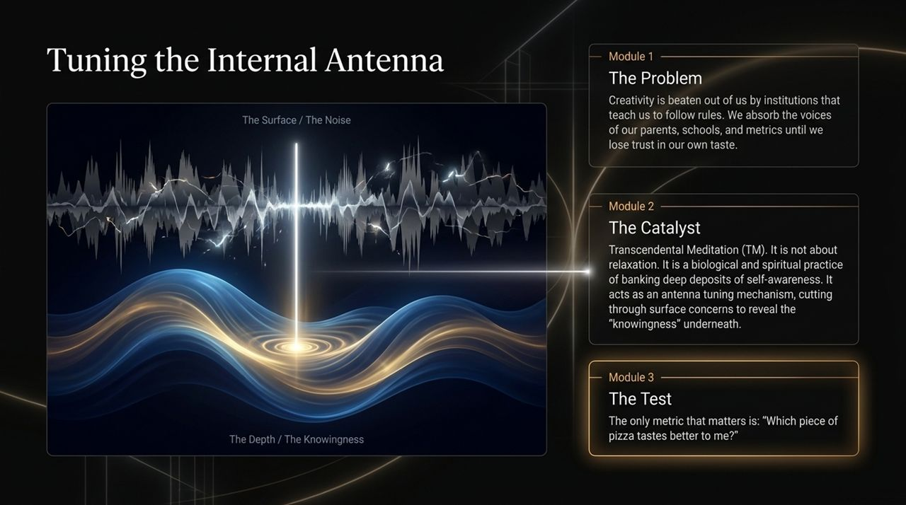
Notes:
As artificial intelligence reshapes creative industries, many worry that AI will render human creativity obsolete. To understand why that isn't the case, we look at the Prompt vs. Execution Architecture: Historically, execution was the highest hurdle. But history shows us that vision has always outranked technical execution. Andy Warhol didn't manually screen-print every piece; he gave instructions to assistants in his Factory. Alfred Hitchcock fully storyboarded his movies down to the frame before setting foot on set. AI is the ultimate studio assistant. It can execute production tasks instantly. But AI lacks a unique Point of View. It has no personal taste, no human trauma, no joy, and no distinct lens on existence. Because the barrier to execution has dropped to zero, execution itself is commoditized. The true value of art moves entirely to ideation, perspective, and human discernment.

Slide 9
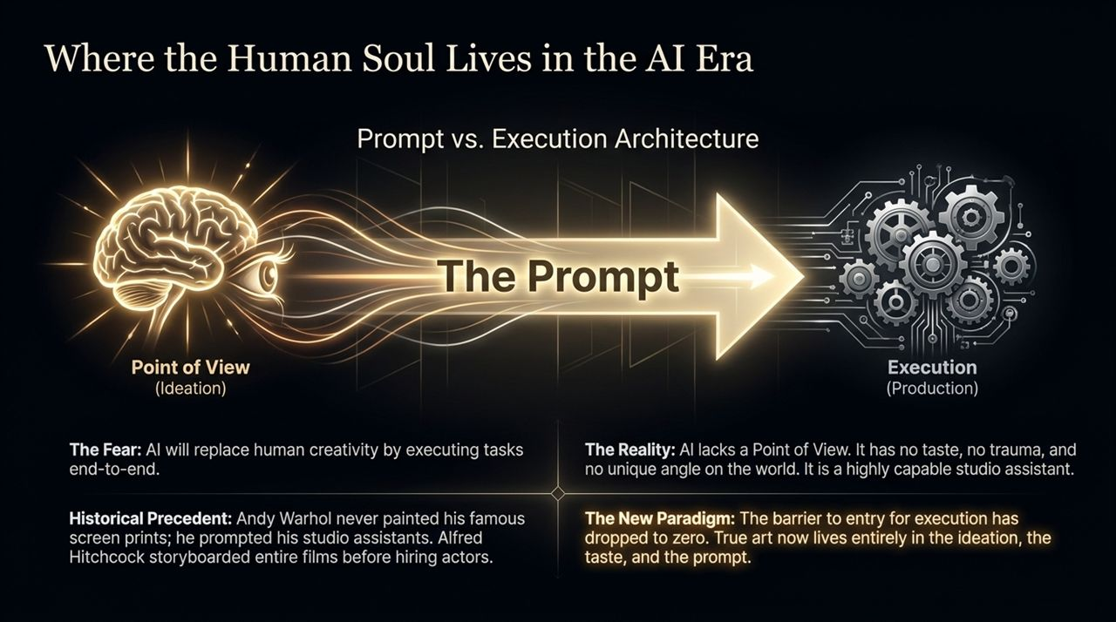
Notes:
There is a myth that 'real' creators follow a specific, rigid working method. The truth is that every great artist develops an internal mechanism tailored to their mind.
Consider how Jay-Z recorded the classic track '99 Problems' with Rick Rubin:
While most rappers filled notebooks with lyrics, Jay-Z didn't write down a single line. He asked Rick to loop the beat for 30 minutes straight. He sat quietly in the back of the studio, humming and mumbling.
After 30 minutes, he stepped up to the microphone and delivered complete, intricate verses directly from memory, adjusting his cadence like a jazz musician.
Compare that to Eminem, who writes constantly—filling stacks of notebooks with rhymes he may never use, just to sharpen his technique.
Neither process is superior. The key is finding the exact workflow that allows you to bypass self-doubt and access your instincts.

Slide 10
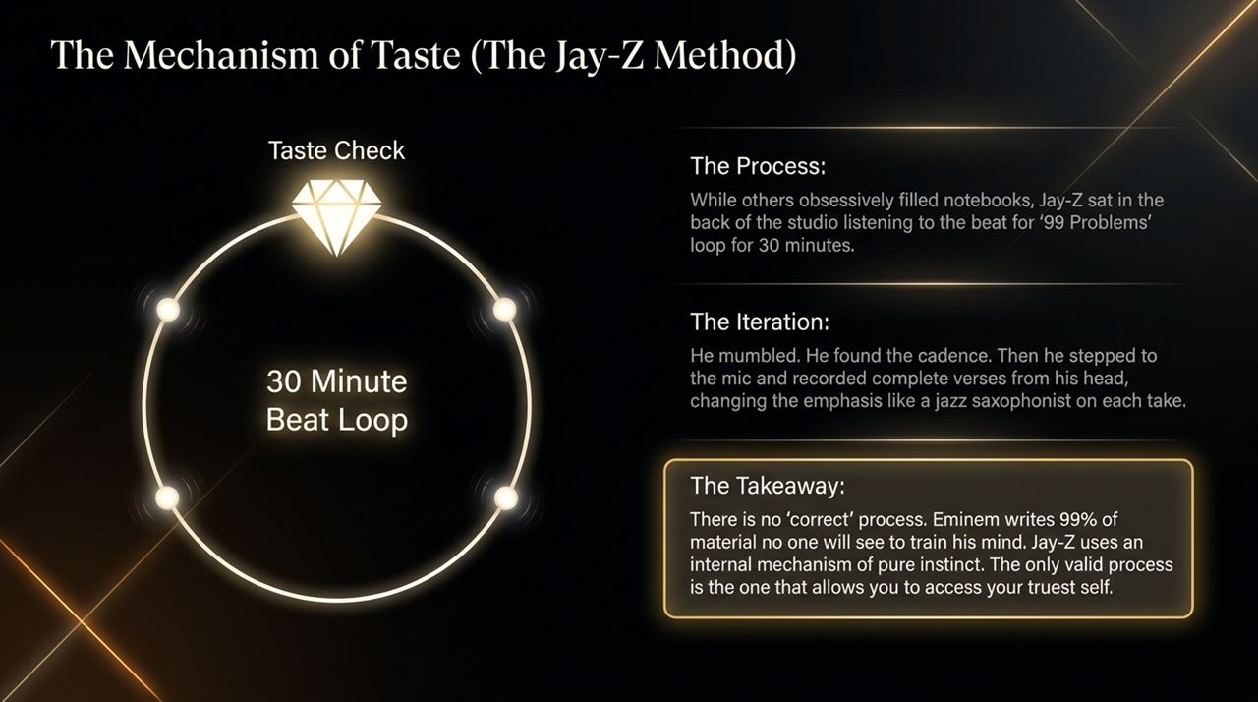
Notes:
Most commercial work operates on a horizontal axis: Creator to Consumer. You create a product to exchange for sales, likes, reviews, or market validation.
Rubin advocates for The Epiphany Axis Shift—moving to a vertical axis: Creator to Higher Intelligence.
When you approach creation as a higher offering or a diary entry, your relationship to the work changes entirely.
Rubin states: 'I came to realize we're making it as an offering... I want to show you my best out of love and gratitude. There is no metric that competes with that.'
Art is ultimate self-expression. Consciousness explores the world through individual experience. Your job is simply to say, 'This is how I see the world,' and invite others to show who they are. When you frame your work as an offering rather than a transaction, you build something timeless.

Slide 11
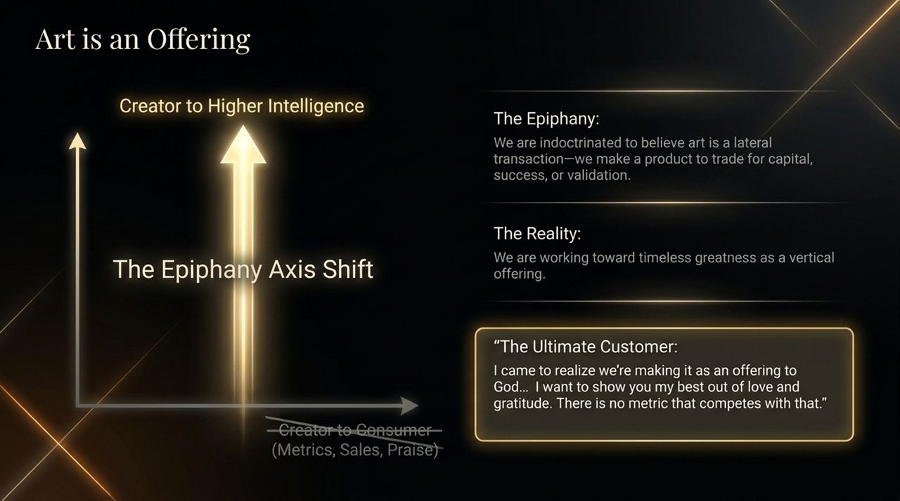
Notes:
As we look at this image of the human brain, let’s reflect on where we spend most of our working lives.
We spend our days analyzing metrics, evaluating risk matrices, and optimizing for external approval. We train our logical left-brain to solve analytical problems.
Intellectual analysis is valuable for execution, but it cannot generate original artistic vision. Pure logic only operates on what already exists.
To make breakthrough discoveries, we must transcend analytical overthinking and tap into deep subconscious intuition.

Slide 12
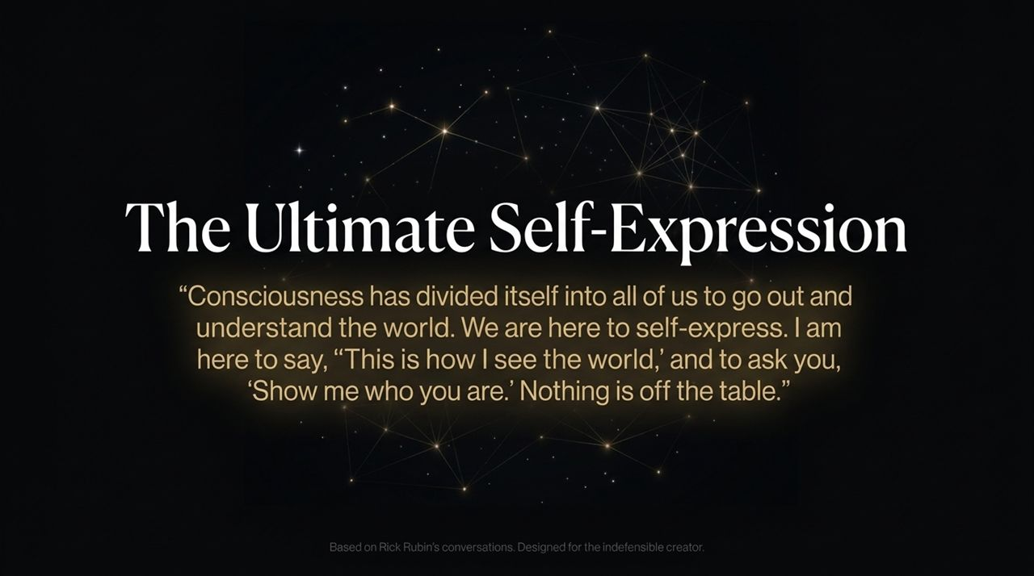
Notes:
This image represents the moment a creator breaks free from constraints.
The chains represent metric-driven thinking, the fear of public judgment, rigid job titles, and short-term expectations.
When you step onto the indefensible path, you break those chains. You stop asking for permission to create. You step into authentic expression, fully accountable to your own taste and vision.

Slide 13
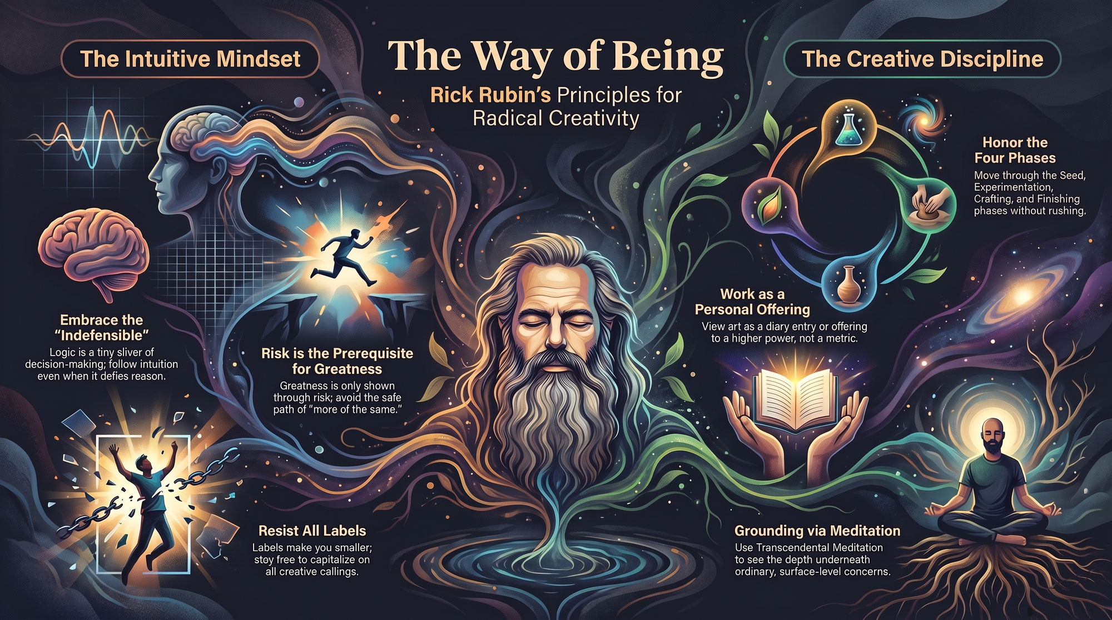
Notes:
To close, let's review the six foundational principles of The Intuitive Mindset:
1. Embrace the 'Indefensible': Rational logic is only a small part of decision-making. Follow your intuition even when you cannot defend it on a spreadsheet.
2. Risk is the Prerequisite for Greatness: Playing it safe leads to cultural obsolescence. True impact requires stepping into the unknown.
3. Work as a Personal Offering: Treat your creation as a personal diary entry or an offering to a higher power, rather than a commodity optimized for metrics.
4. Resist All Labels: Keep your identity flexible. Refuse labels that limit your creative exploration.
5. Grounding via Meditation: Build daily practices to quiet surface noise and maintain direct connection to your internal knowingness.
6. Honor the Four Phases: Protect your discovery process. Allow the Seed, Experimentation, and Crafting phases to unfold without premature deadlines, applying target dates only to the Finishing phase.
By putting these principles into practice, we build work that stands the test of time.
Rick Rubin: The Only Skill That Matters Now Is The One Thing AI Can Never Steal!
https://www.youtube.com/watch?v=a_GiFiHXJ6g

